Slide 1



DESIGN THINKING
INTERNET OF THINGS
Presented By Group 10

Slide 2
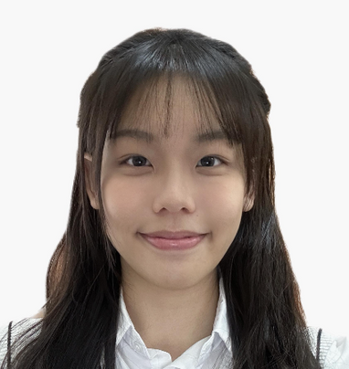
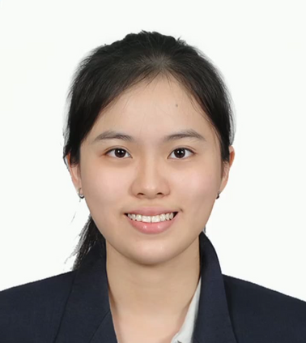



Meet The Group
Chau Ying Jia
Gui Kah Sin
Sabrina Heng Wei Qi
Poh Lok Yee
Woo Cheng Shuan
Group Member
Group Member
Group Leader
Group Member
Group Member

Slide 3
Internet of Things
COMMUNICATION
SENSOR
INTERNET
OF
THINGS
CONNECTIVITY
USER
INTERFACE

Slide 4



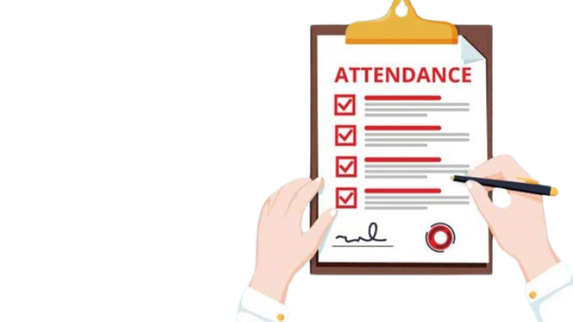
Intro
‘AttendEase’
Our team developed 'AttendEase', an IoT-based smart classroom technology, to address concerns about weakness of QR code attendance systems and security.

Slide 5
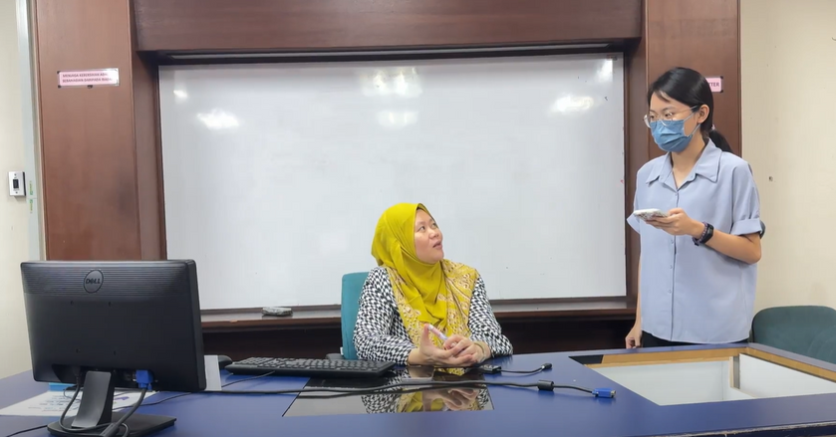
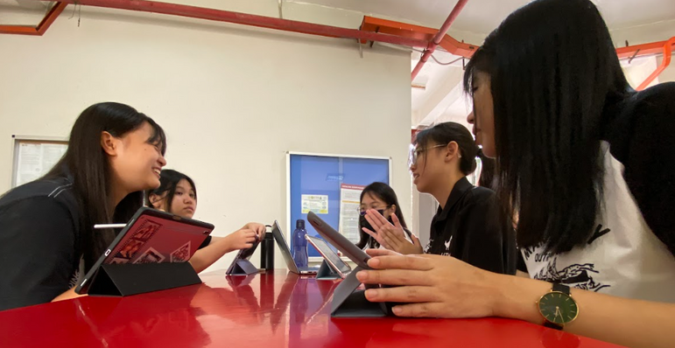
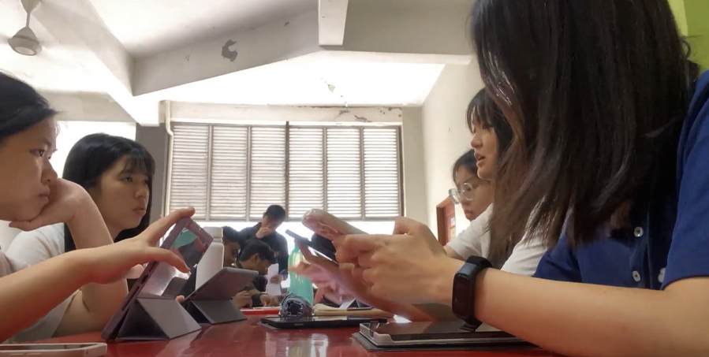
Evidence
Interview with Dr. Eliyah on 17th Oct 2023
First Discussion on 24th Oct 2023
2nd Discussion on 30th Oct 2023

Slide 6
Empathy
1. Interview session
Interviewer: Gui Kah Sin
Interviewer: Dr. Eiliyah Wong
About: what problem does she faced and what is the suggestion solution

Slide 7
DEFINE
main problem
Fake attendence concern

Slide 8

Ideate
Traditional
Paper-based
Application
Students write down their names on the papers for lecturers to refer to.
By using an application for attendance, which could have added some other functions.
By calling out students’ name and recordind them down.

Slide 9
Problems & Solutions
Fake attendance
concerns
For security concerns
For emergency purpose
1
2
3
Students must do the self-check-in for attendance using the face recognition or fingerprint on our device in each lecture location
The CCTV camera on our device are “ON” for 24hours to make sure the security of each classroom or lecture hall.
-Lecturers able to access those camera playback.
Lecturers can use remote communication function in our application to communicate or give instruction directly (real time communication)

Slide 10
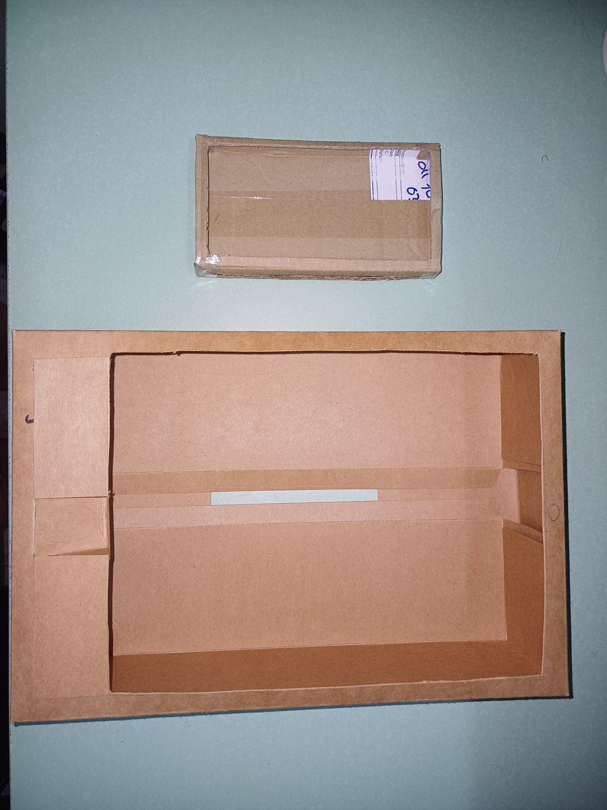
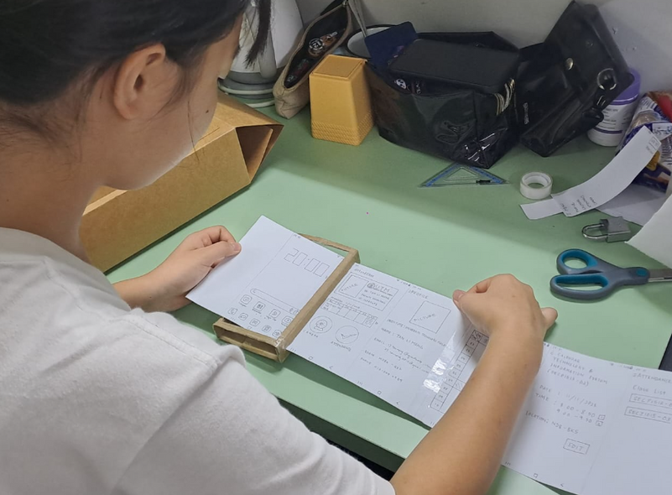
Prototype
We choose the best and suitable way to solve the problems and built a prototype which is application and device.

Slide 11
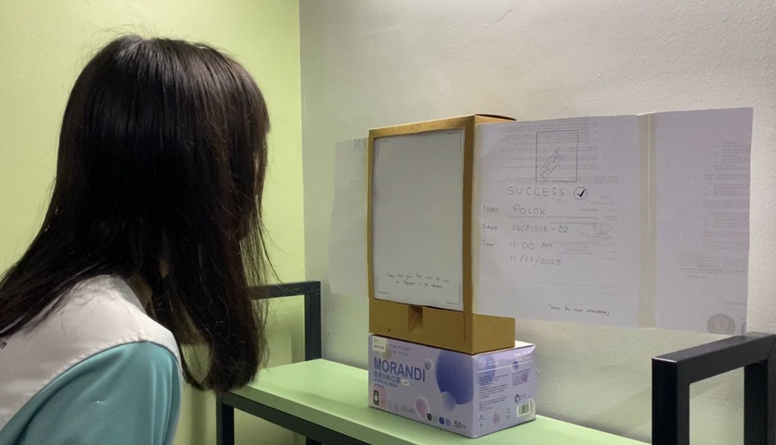
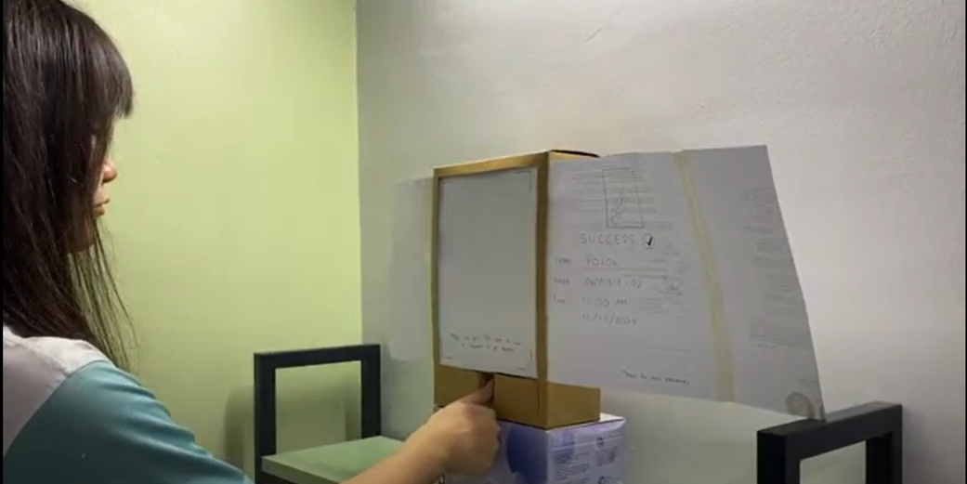
Testing
When the product is done, we demonstrate and test our products with different users.
https://youtu.be/KqJsBg-bVsE

Slide 12
THANK YOU
By Group 10

